Slide 1

CC-215 Database Systems
— Unit 7 — Extended or Enhanced ER Model
Some slides and/or pictures are adapted from Lecture slides / Books of
Peter Rob
Jeffery. A. Hoffer
Thomas M. Connolly
Ramez Elmasri
Silberschtaz
Dr. Asif Sohail University of the Punjab Department of Information Technology, FCIT

Slide 2
Outline
Introduction
Supertype - Subtypes
Basic Notations of Supertype – Subtypes
Supertype – subtypes Relationship
Supertype – subtypes Examples
Generalization
Specialization
Subtypes Discriminator
Supertype – subtypes Hierarchy
Specialization Hierarchy
Entity Clustering

Slide 3
Introduction
It extends original E-R model with new modeling constructs.
Used to cope with the dynamic and complex business environment.
It uses the representations for supertypes and subtypes.
The following three design options are possible.
Define a single entity type Employee with all the possible attributes in it.
Define a separate entity type for each employee type.
Define a supertype with all the common attributes and introduce its subtypes having only the applicable attributes.
EMPLOYEE TYPE | ATTRIBUTES
1. Hourly | ENo, EName, Address, Hire_Date, Hourly_Rate
2. Salaried | ENo, EName, Address, Hire_Date, Salary
3. Contract | ENo, EName, Address, Hire_Date, Rate

Slide 4
Supertype - Subtypes
A Super type is a generic entity type that is subdivided into subtypes. A Subtype is a subset of a super type that shares the common attributes of the super type plus it has some of its own attributes that distinguish it from other subtypes.
The super type and subtypes employ the concept of Generalization and Categorization.
Generalization is the concept that some entities are subtypes of other more general entities. E.g. Bird, Vehicle etc.
Categorization is the concept that an entity comes in various subtypes.
Super type & Subtype representation is used to represent the entities that are very much similar.
Attribute Inheritance:
Subtype entities inherit values of all attributes of the supertype
Subtype entities inherit their primary key from their supertype
An instance of a subtype is also an instance of the supertype

Slide 5
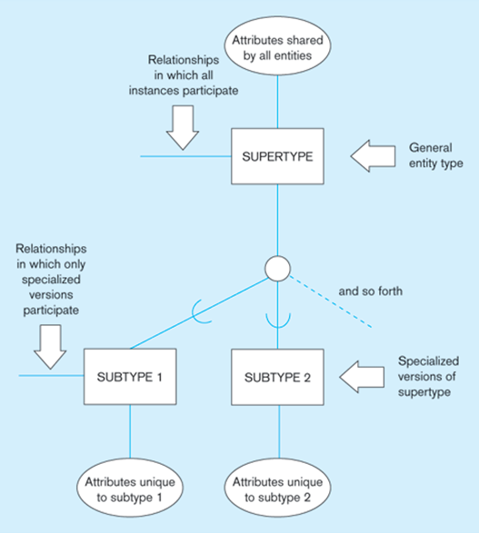
Basic Notations of Supertype - Subtypes

Slide 6
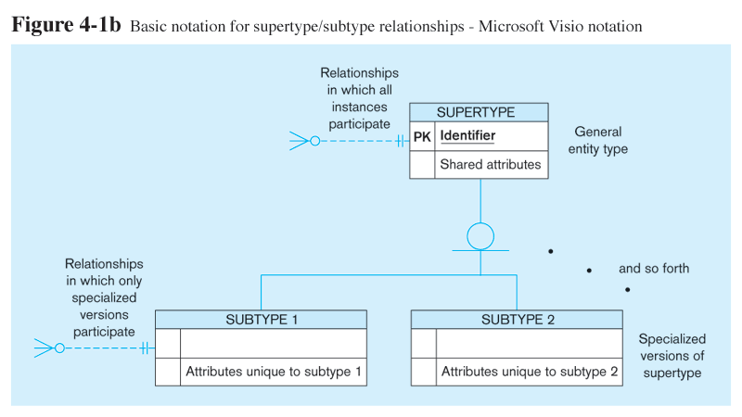
Basic Notations of Supertype - Subtypes
Different modeling tools may have different notation for the same modeling constructs

Slide 7
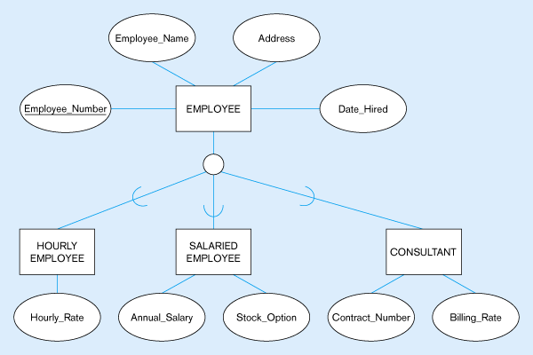
Employee Supertype with Three Subtypes
All employee subtypes will have Emp_Number, Name, Address, and Date-Hired attributes
Each employee subtype also has its own attributes

Slide 8
Supertype – Subtypes Relationship
The relationship between each subtype and its super type is called ISA relationship.
The relationship is read from the subtype to the super type.
The cardinality of the relationship from subtype to super type is always mandatory one, and the cardinality and from super type to subtype is optionally one.
Henceforth, cardinality may be omitted in diagram .
Common attributes of both subtypes
Specific attributes of the subtypes of faculty

Slide 9
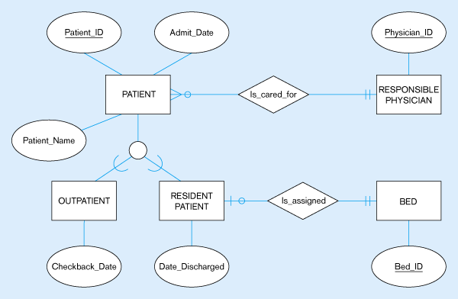
Supertype – Subtypes of a Hospital System
Both outpatients and resident patients are cared for by a responsible physician
Only resident patients are assigned to a bed

Slide 10
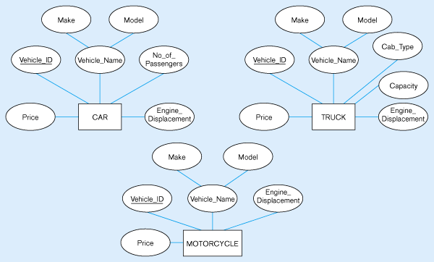
Generalization
All three types of vehicles have common attributes

Slide 11
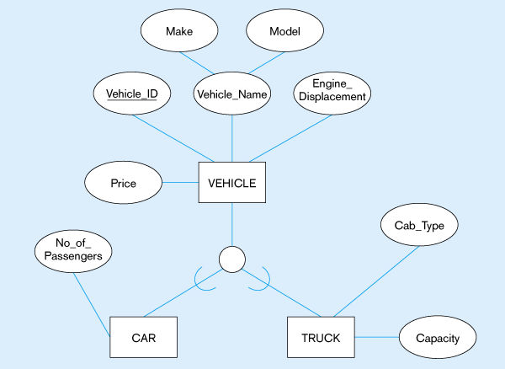
Generalization
Common attributes are connected with the supertype.
No subtype for Motorcycle, as it doesn’t have any specific attribute(s).

Slide 12
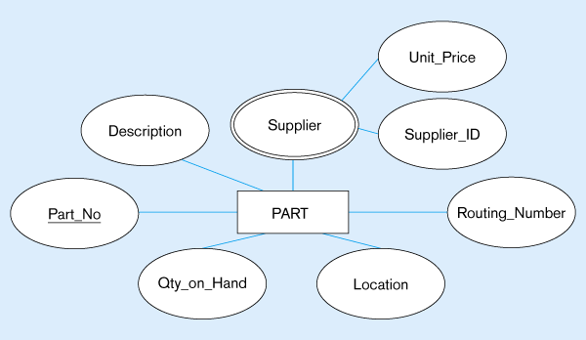
Specialization
Applies only to purchased parts
Only applies to manufactured parts

Slide 13
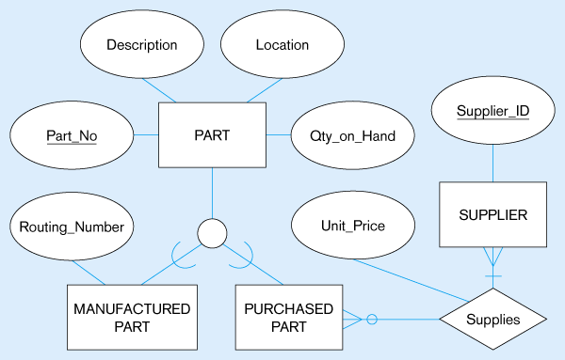
Specialization
Created 2 subtypes
Note: Multivalued attribute is replaced by a relationship to another entity

Slide 14
Generalization Constraints
1. Completeness Constraint
All the subtypes have been defined and there can’t be any further subtypes.
Exhaustive / Non-Exhaustive Subtypes
2. Disjointness Constraint
Exclusive / Non-Exclusive Subtypes
Criterion | Ans? | Rule / Constraint
Each instance of a supertype must be a member of at least one subtype? | Yes | Total Specialization
 | No | Partial Specialization
Criterion | Ans? | Rule / Constraint
Each instance of a super type is categorized as exactly one subtype? | Yes | Disjoint (d)
 | No | Overlap (o)

Slide 15
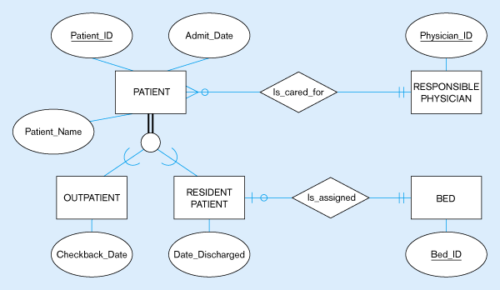
Total Specialization Rule
A patient must be either an outpatient or a resident patient

Slide 16
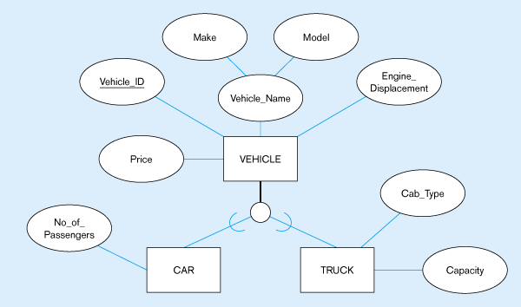
Partial Specialization Rule
A vehicle could be a car, a truck, or neither

Slide 17
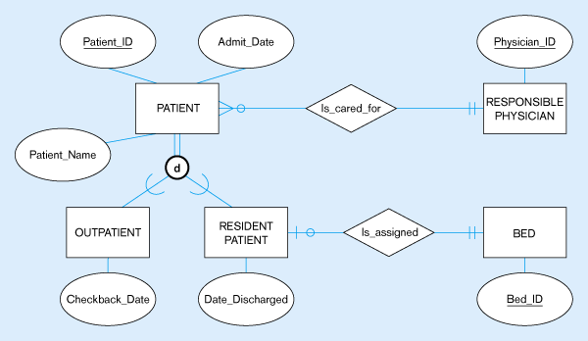
Disjoint Rule
A patient can either be outpatient or resident, but not both

Slide 18
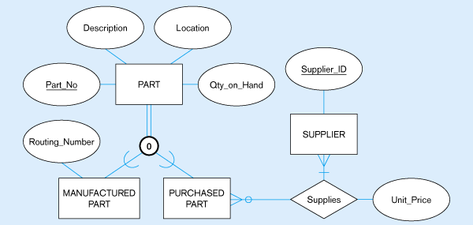
Overlap Rule
A part may be both purchased and manufactured

Slide 19
Subtype Discriminators
An attribute of the super type whose values determine the target subtype(s)
Disjoint – a simple/atomic attribute with alternative values to indicate the possible subtypes
Overlapping – a composite attribute whose subparts pertain to different subtypes. Each subpart contains a Boolean value to indicate whether or not the instance belongs to the associated subtype

Slide 20
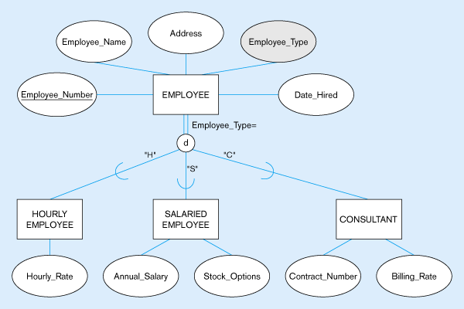
Subtype Discriminator (Disjoint Rule)
A simple attribute with different possible values indicating the subtype

Slide 21
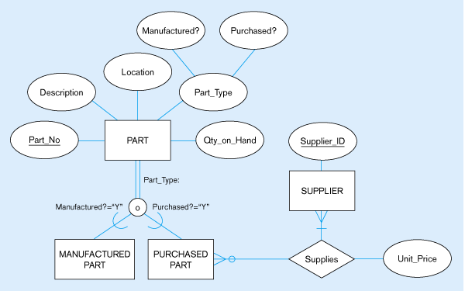
Subtype Discriminator (Overlap Rule)
A composite attribute with sub-attributes indicating “yes” or “no” to determine whether it is of each subtype

Slide 22
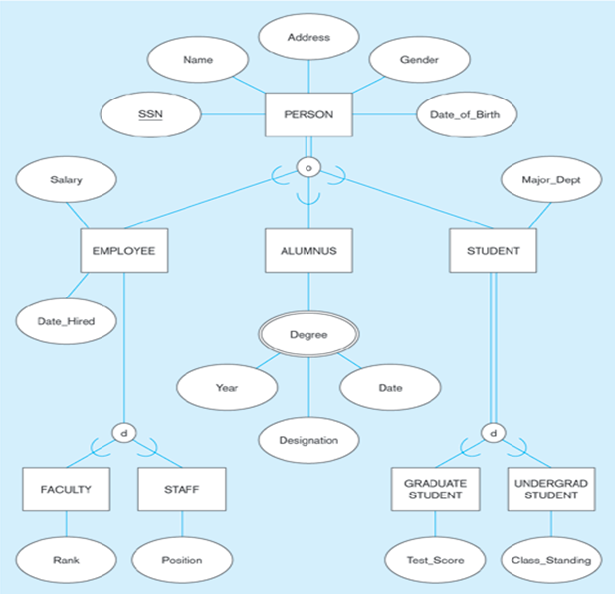
Supertype – Subtypes Hierachy

Slide 23
Specialization Hierarchy (Tree Structure or Strict Hierarchy)

Slide 25
Specialization Lattice
Shared Subset
An entity set that is a subset of two or more supersets.

Slide 26
UNION
A subtype is related to any one of the supertypes.

Slide 27
Entity Clustering
Entity clustering is a useful way to present a data model a large and complex systems involving hundreds of entities.
An entity cluster is a virtual entity type formed by combining multiple related entities.
Referring to the examples discussed, the entities related employee, patient, part can be clustered together.
The cardinalities of the relationships of the clustered entities with the other entities remain the same.

Slide 28
Reading Material
Database Systems – Design, Implementation and Management: Carlos Coronel, Steven Morris (13th Ed.)
Modern Database Management: Jeffery. A. Hoffer (12th Ed.)
Database Systems: Thomas M. Connolly (6th Ed.)
Fundamentals of Database Systems: Elmasri (7th Ed.)
Database System Concepts: Abraham Silberschatz (7th Ed.)
Databases Illuminated: Catherine M. Ricardo (3rd Ed.)
Book | Section(s) / Chapter
A | Sections 5.1, 5.2
B | Pages 114 to 134
C | Sections 12.1, 12.3
D | Chapter 4
E | Section 6.8
F | 3.9 to 3.12

